Slide 1
Game of Loans
Karthik Teja Katreddi, Saket Talware, Trevor Toll

Slide 2
Introduction
This project involves development of a classification model to predict whether a loan would be a charge off or not.
The dataset used for this project is that of lending club, a peer to peer lending service company.

Slide 3
Rise of Peer to Peer Lending

Slide 4
Peer-to-peer Lending
Peer-to-peer(P2P) lending enables individuals to obtain loans directly from other individuals,cutting out the financial institutions as the middleman.
Also known as crowdlending, many peer-to peer loans are unsecured loans, though some of the largest amounts are lent to businesses.

Slide 5
What is the reason for this?

Slide 6
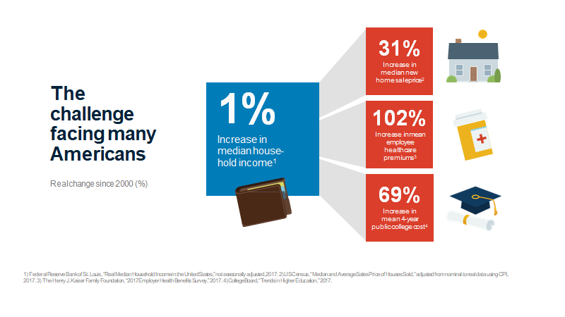

Slide 7
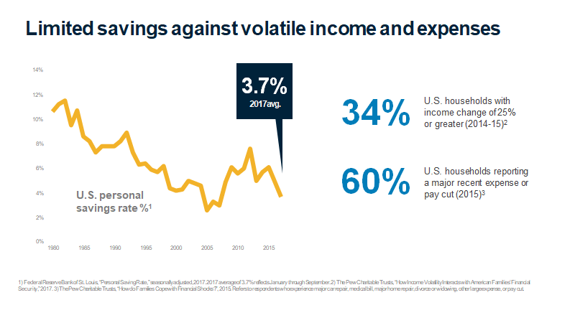

Slide 8
Risks to investors in peer to peer lending.
There is increased risk to investors when they provide unsecured loan.
Out of this charge-off is of the most significance.
A charge-off is a debt that is deemed unlikely to be collected by the creditor because the borrower has became substantially delinquent after a period of time.

Slide 9
Lending Club

Slide 10
Lending Club
Borrowers apply for loans and investors open an account.
Borrowers get funded and investors build a portfolio
Borrowers repay and investors earn & reinvest.

Slide 11
Problem Statement
Delinquent loans reduce profit for money lenders.
When a loan account has become delinquent to the point that it is unlikely to ever be collected, the lender does a charge-off. Ideally, all accounts make payments on time and never become a charge-off, but the reality is that lending money involves taking a risk that the loan applicant will not repay them.
Part of the loan process is assessing the risk of a loan application to reduce the likelihood of charge-off and maximize the amount of loans that stay current. Using Python, Spark, and MLlib, a classification model could be trained to predict the probability of a charge off.
Such a model could help loan officers decide whether a loan makes financial sense to approve.

Slide 12
Dataset
We have used the lending club loan dataset that was available on Kaggle.
It consist of 2.26 m rows and 75 total columns.
The columns mostly contain information about the borrower, the reason for taking the loan and the loan status.
There is a lot of missing data.
Also, there are many loan applications that are current meaning we don’t know whether they ended up as charge off or were paid.

Slide 13
Our Approach
Select the most important features from the dataset that our of value.
Handle missing values.
Assign a probability score to each loan that predicts the probability that the loan will end up a charge-off.
We have trained a classification model that accepts inputs of the loan and returns a probability score.

Slide 14
Feature Selection
Generally, It is a method to find the subset of features that produces better model for given dataset.
Removing irrelevant and redundant data.
Improving learning accuracy and result comprehensibility.
We use Chi-Squared feature selection.
It operates on labeled data with categorical features.
Uses Chi-Squared test of dependence to decide features.

Slide 15
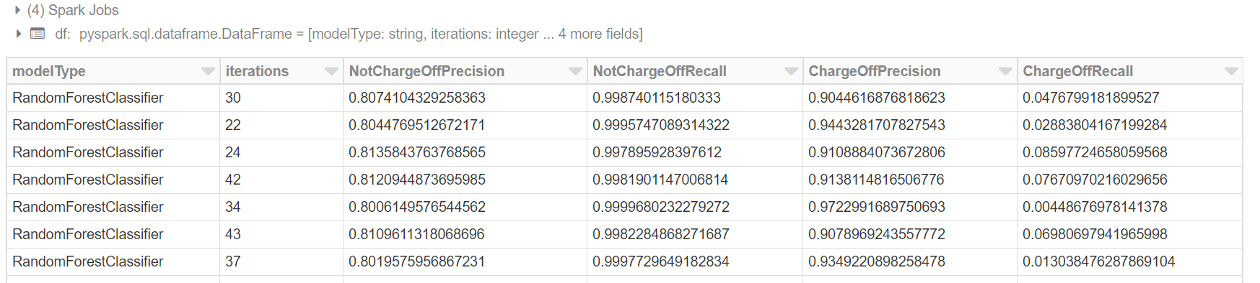
Model Development
Transformation/Cleaning using PySpark DataFrames
SparkSQL
WithColumn functions
Transformation using PySpark Pipeline
StringIndexer
OneHotEncoderEstimater
Iterating through different model parameters and writing results to parquet files to store and later visualize

Slide 16
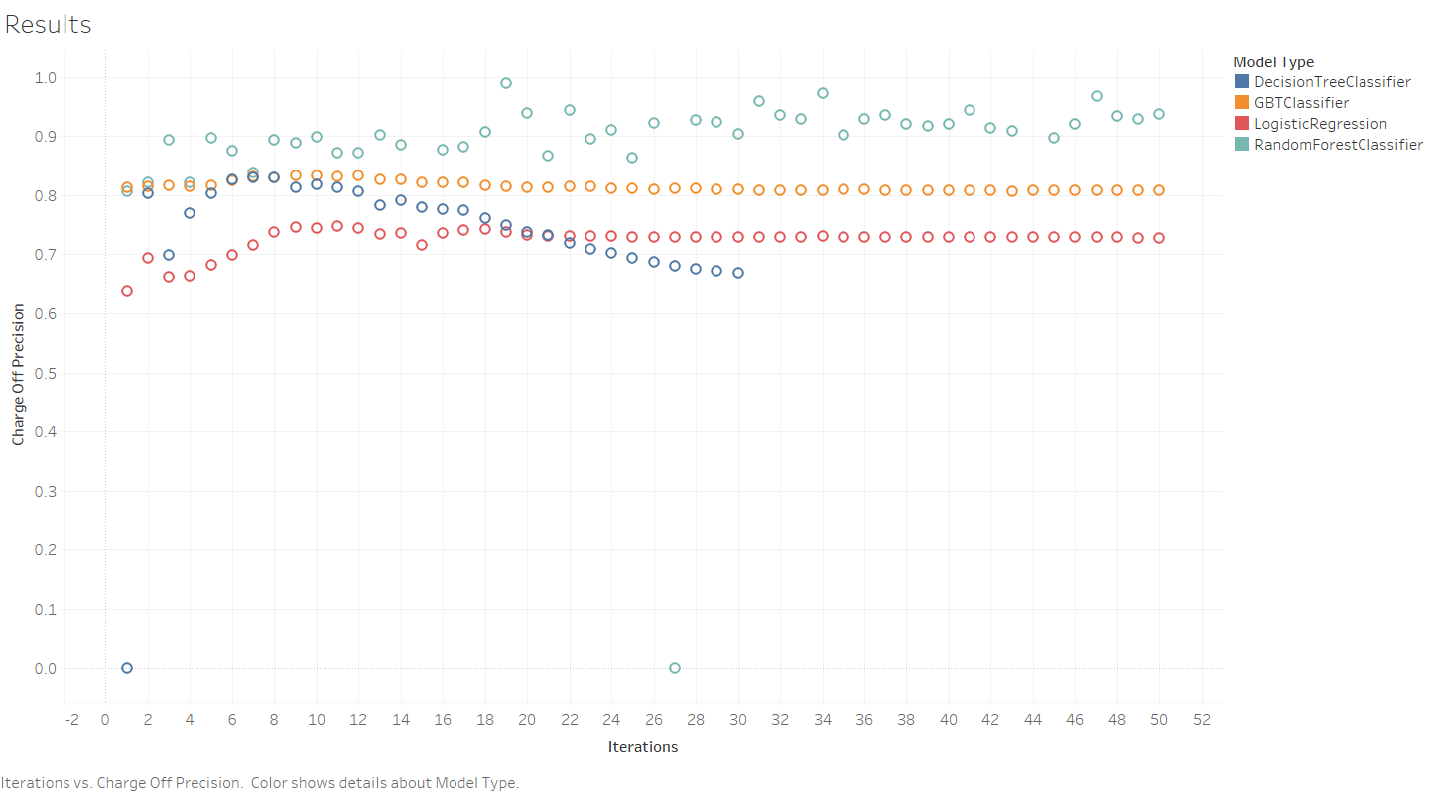

Slide 17
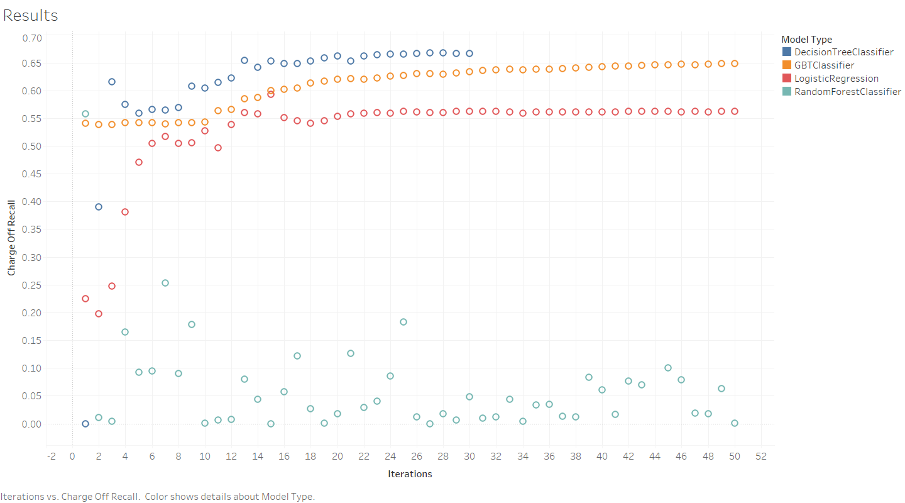

Slide 18
Why Cloud for this type of problem?
Distributed Compute
Dedicated Compute
Easy storage and training of pipelines
Easy storage of model results
Collaborative workspaces

Slide 19
Acknowledgements
Kaggl.com [12]
Lendingclub.com[6][7]

